Slide 1

Embedded C
Trainer:
Bhumika Narang
C-DAC

Slide 2
Embedded C
Basics of Program Writing & Coding Practices
Overview of C Programming language
Introduction to GNU Toolchain and GNU Make utility
Linux environment and vi editor
Tokens of C - Keywords, Datatypes, Variables, Constants, Operators, Identifiers
Storage Class Specifiers
Control Flow Statements
Arrays and Multidimensional arrays
Data Input & Output
Strings, Loops, Functions and Recursion
Pointers, Pointer Arithmetic, Pointers and Arrays, Pointers and Functions, Pointers and Strings
Structures, Unions, Enum and Typedef
Bit field operators and pointers with structures
Preprocessors, C and Assembly
Files with I/O operation
Variable number of arguments and Command Line arguments
Error handling, Debugging and Optimization of C programs
Bit operations
Handling portability issues in C, Hardware, Time, Space and Power aware Programming

Slide 3
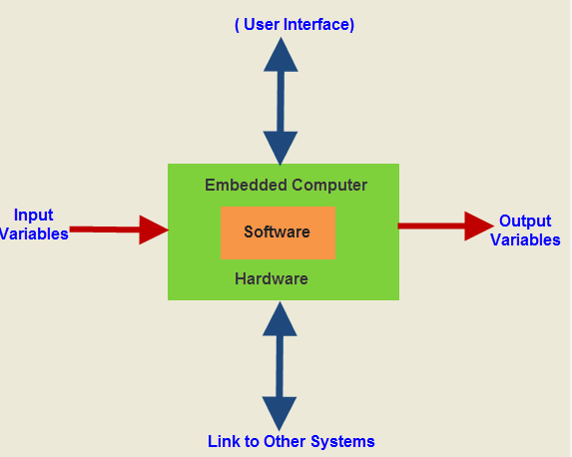
Introduction to Embedded Systems

Slide 4
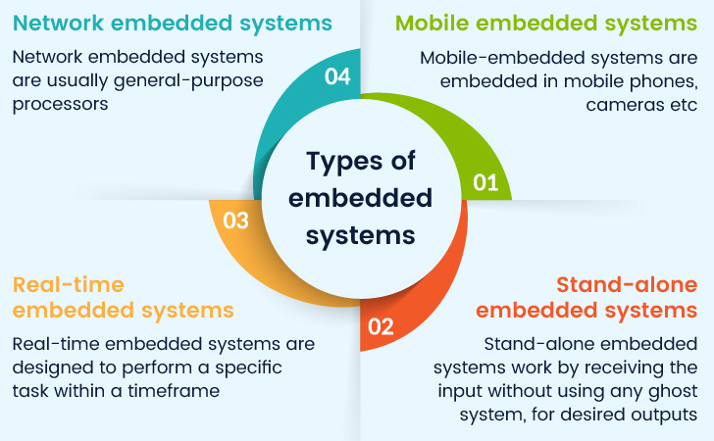

Slide 5
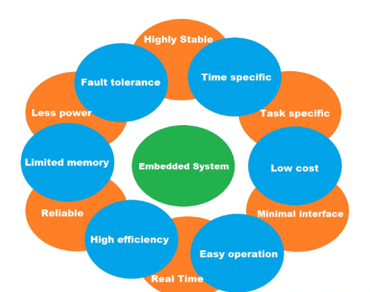
Characteristics of Embedded Systems

Slide 6
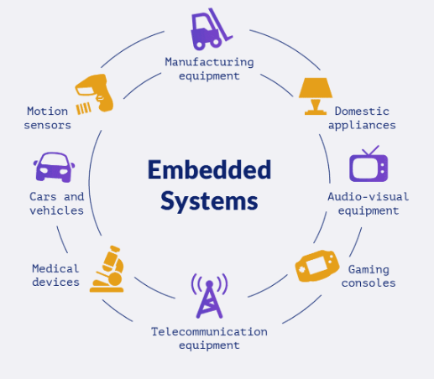
Applications of Embedded Systems

Slide 7
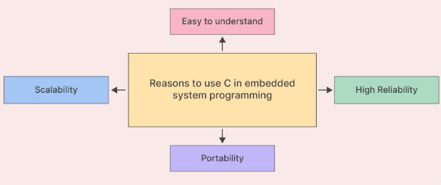
Reasons to use C in Embedded Programming

Slide 8
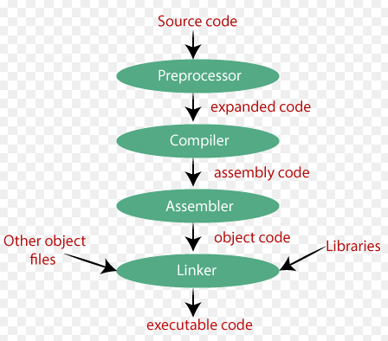

Slide 9
Basics of Program Writing
Problem Definition
Planning
Coding
Testing
Documentation
Optimization

Slide 10
Good Coding Practices
Consistent Naming Conventions
Code Organization
Readability
Error Handling
Code Reusability
Version Control
Testing
Code Reviews

Slide 11
Key Features of C
Simple and Efficient
Low-Level Access
Modularity
Portability
Rich Set of Operators

Slide 12
Software Installation
GCC (MinGW)
Download Link - https://jmeubank.github.io/tdm-gcc/download
VS Code
Download Link - https://code.visualstudio.com/Download

Slide 13
Structure of C Program
header | #include <stdio.h>
global variable/function declaration | int a = 100;
main() | int main() {
local variable declaration | int b = 200;
body | printf("%d\n",a); printf("%d\n",b); printf("Hello, World!\n");
return | return 0; }
Commands to run the code:
cmd> gcc filename.c
Cmd> ./a.exe

Slide 14
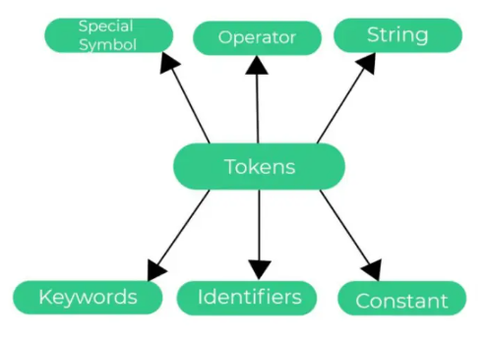
Tokens of C

Slide 15
Keywords Reserved words that have special meaning in C
int
return
if
else
while
for
break
continue
switch
case
default
goto
sizeof
typedef
static
strut
union
enum
const
volatile
register
extern,
auto
void
signed
unsigned
short
long
char
float
double

Slide 16
Identifiers Constants
Names given to various program elements such as variables, functions, arrays, and structures.
They are user-defined names.
Must begin with a letter (A-Z or a-z) or an underscore (_). Subsequent characters can be letters, digits (0-9), or underscores.
Identifiers are case-sensitive.
Examples: parity1, adder_full, Test4, project22 etc.
Fixed values that do not change during the execution of a program.
Constants can be of different types such as integer constants, floating-point constants, character constants, and enumeration constants.
Examples: 10, 3.14, 'a', 0x1A, 075, 1.5e3 etc.

Slide 17
Strings Sequence of characters enclosed in double quotes. Examples: “Hello CDAC”, “63457985665” Special Symbols / Separators (Punctuation)
Characters that separate tokens. They define the structure of the code. Examples:
Braces: {, }
Parentheses: (, )
Brackets: [, ]
Semicolon: ;
Comma: ,
Colon: :
Period: .
Ellipsis: ...

Slide 18
Operators
Symbols that specify operations to be performed on operands. C supports a rich set of operators such as:
Arithmetic Operators: +, -, *, /, %
Relational Operators: ==, !=, >, <, >=, <=
Logical Operators: &&, ||, !
Bitwise Operators: &, |, ^, ~, <<, >>
Assignment Operators: =, +=, -=, *=, /=, %=, &=, |=, ^=, <<=, >>=
Increment and Decrement Operators: ++, --
Conditional Operator: ? :
Comma Operator: ,
Sizeof Operator: sizeof
Pointer Operators: *, &

Slide 19
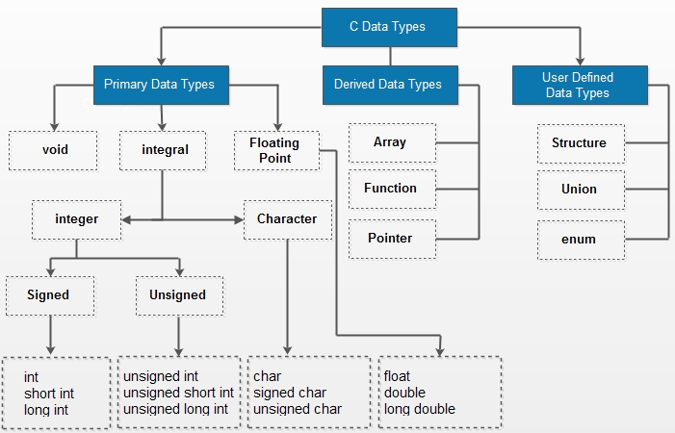

Slide 20
Type | Size (bytes) | Range
char | 1 | -128 to 127 or 0 to 255
unsigned char | 1 | 0 to 255
signed char | 1 | -128 to 127
int | 2 or 4 | -32,768 to 32,767 or -2,147,483,648 to 2,147,483,647
unsigned int | 2 or 4 | 0 to 65,535 or 0 to 4,294,967,295
short | 2 | -32,768 to 32,767
unsigned short | 2 | 0 to 65,535
long | 4 or 8 | -2,147,483,648 to 2,147,483,647 or -9,223,372,036,854,775,808 to 9,223,372,036,854,775,807
unsigned long | 4 or 8 | 0 to 4,294,967,295 or 0 to 18,446,744,073,709,551,615
long long | 8 | -9,223,372,036,854,775,808 to 9,223,372,036,854,775,807
unsigned long long | 8 | 0 to 18,446,744,073,709,551,615

Slide 21
Type | Size (bytes) | Range | Precision
float | 4 | 1.2E-38 to 3.4E+38 | 6 decimal places
double | 8 | 2.3E-308 to 1.7E+308 | 15 decimal places
long double | 10, 12, or 16 | 3.4E-4932 to 1.1E+4932 (implementation-defined, generally larger than double) | 19 decimal places

Slide 22
Data Type |  | Format Specifier
Integer | Short signed Short unsigned Long signed Long unsigned Unsigned hexadecimal Unsigned octal | %d or %i %u %ld %lu %x %o
Real | Float Double | %f %lf
Character | Signed character Unsigned character | %c %c
String |  | %s

Slide 23
Data Types Example
#include <stdio.h>
// Basic data types
char c = 'A’;
int i = 42;
unsigned int ui = 40000;
short s = 32000;
long l = 90000;
long long ll = 123456789012345;
float f = 3.14f;
double d = 3.1415926535;
long double ld = 3.14159265358979323846;

Slide 24
// Derived data types
int arr[5] = {1, 2, 3, 4, 5};
struct Person
{
char name[50];
int age;
float salary;
} person1 = {"John Doe", 30, 50000.0};
union Data {
int i;
float f;
char str[20];
} data;
enum Weekday { Sunday, Monday, Tuesday, Wednesday, Thursday, Friday, Saturday };
enum Weekday today = Wednesday;

Slide 25
int main()
{
data.i = 10;
printf("Data as integer: %d\n", data.i);
data.f = 220.5;
printf("Data as float: %f\n", data.f);
snprintf(data.str, 20, "Hello, World!");
printf("Data as string: %s\n", data.str);
printf("Today is: %d\n", today);
return 0;
}

Slide 26
Variables in C
Declaration
int age;
float salary;
char grade;
Initialization
int age = 25;
float salary = 5000.50;
char grade = 'A';
Multiple Declarations
int a = 1, b = 2, c = 3;
float x = 1.2, y = 3.4, z = 5.6;

Slide 27
Types of Variables
1. Local Variables
void myFunction() {
int localVar = 10;
}
2. Global Variables
int globalVar = 100;
void func1() {
globalVar = 200; // Access and modify global variable
}
void func2() {
printf("%d", globalVar); // Access global variable
}

Slide 28
3. Static Variables
i) Local Static Variables:
void myFunction() {
static int counter = 0; // Static local variable
counter++;
printf("%d", counter);
}
ii) Global Static Variables:
static int globalVar = 100; // Static global variable
void func1() {
globalVar = 200;
}
void func2() {
printf("%d", globalVar);
}

Slide 29
4. External Variables
// File1.c
int externalVar = 10; // Definition of external variable
// File2.c
extern int externalVar; // Declaration of external variable

Slide 30
Example:
#include <stdio.h>
int globalVar = 10; // Global variable
void func1() {
int localVar = 20; // Local variable
printf("Local variable in func1: %d\n", localVar);
globalVar = 30; // Accessing global variable
printf("Global variable in func1: %d\n", globalVar);
}
void func2() {
static int staticVar = 0; // Static local variable
staticVar++;
printf("Static variable in func2: %d\n", staticVar);
}

Slide 31
int main() {
func1();
func2();
func2(); // Accessing global variable in main
printf("Global variable in main: %d\n", globalVar);
return 0;
}
Output:
Local variable in func1: 20
Global variable in func1: 30
Static variable in func2: 1
Static variable in func2: 2
Global variable in main: 30

Slide 32
Constants in C
#include <stdio.h>
#define PI 3.14159 // Symbolic constant
int main() {
// Integer constants
int decimal = 123; // Decimal constant
int octal = 0173; // Octal constant
int hex = 0x7B; // Hexadecimal constant
// Floating-point constants
float floatNum = 123.45f;
double doubleNum = 123.45;
long double longDoubleNum = 123.45L;

Slide 33
// Character constants
char char1 = 'A';
char newline = '\n';
char tab = '\t';
// String constants
char str1[] = "Hello, World!";
char str2[] = "C programming";
// Constant variables
const int MAX = 100;

Slide 34
// Printing constants
printf("Integer Constants: %d, %d, %d\n", decimal, octal, hex);
printf("Floating-point Constants: %f, %lf, %Lf\n", floatNum, doubleNum, longDoubleNum);
printf("Character Constants: %c, %c, %c\n", char1, newline, tab);
printf("String Constants: %s, %s\n", str1, str2);
printf("Symbolic Constant PI: %f\n", PI);
printf("Constant Variable MAX: %d\n", MAX);
return 0;
}
Output:
Integer Constants: 123, 123, 123
Floating-point Constants: 123.449997, 123.450000, 123.450000
Character Constants: A,
,
String Constants: Hello, World!, C programming
Symbolic Constant PI: 3.141590
Constant Variable MAX: 100

Slide 35
Thank You

